Slide 1



Angular 2
Better or worse?
Vladimir Georgiev
Technical Trainer &
Software Developer @ SoftUni
http://VGeorgiev.org/
@VGeorgiew

Slide 2


Table of Contents
Who am I?
Where Angular 1 is going?
v1.3
v1.4
v1.5
Angular 2
Demo

Slide 3

Who am I?
Vladimir Georgiev
Software Engineer and Technical Trainer @ Software University
Top performing graduate from the Telerik Software Academy (2013)
Student in Technical University
Computer and Software Engineering
Web site & blog: www.VGeorgiev.org
Twitter: @VGeorgiew

Slide 4

Have you ever written Angular?

Slide 5

Let's start with Angular 1

Slide 6

Angular 1 is not dead!
Notes:
Понеже Angular team са пичове и освен, че искат да подобрят Angular, като го пренапишат, за тях е много важно мнението на хората и какво им харесва на тях. Също така на коя платформа разработват своите приложения.

Slide 7
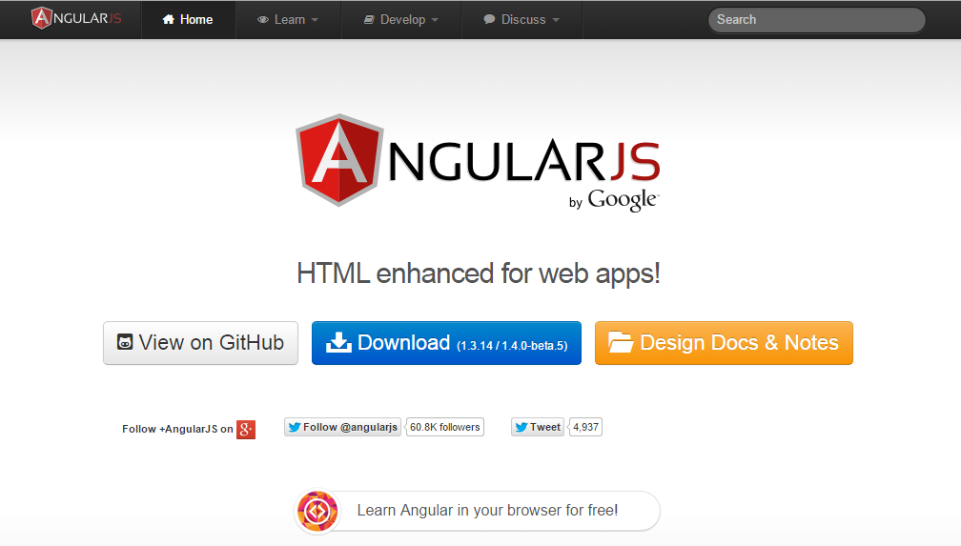
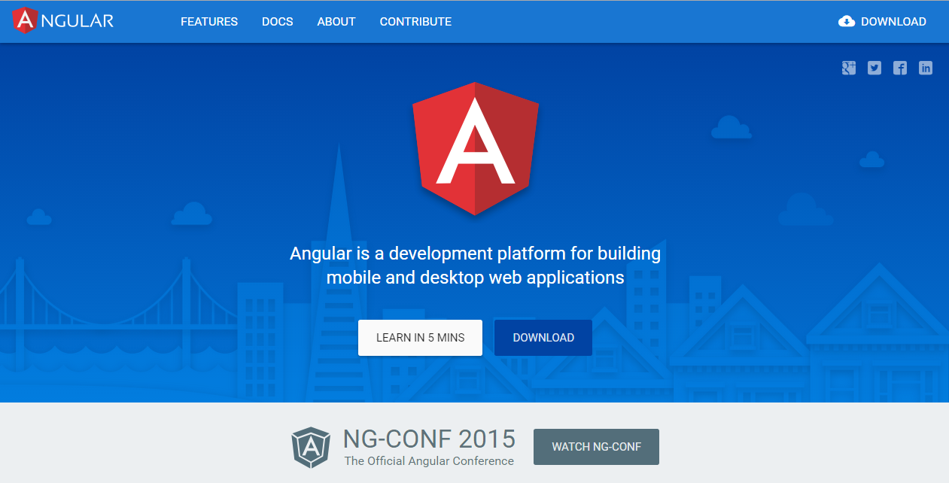
Angular 1 vs Angular 2 sites
angularjs.org
angular.io
Notes:
How we are going to split our development between Angular 1 and Angular 2
Based on where you are spending your time
There're going to use the traffic between Angular 1 and Angular 2 sites to gauge interest in the community as to where you are spending your time

Slide 8
Angular 1.3
Patch releases
Bug fixes
Small features

Slide 9
Angular 1.4
New Router
Internationalization
ng-animate, ng-messages, ng-cookies
…
Notes:
ng-messages
ng-cookies
ability to set path and domain
clean up cookie update process
CommonJS – friendly builds
injector – print caller name in "unknown provider" errors
ng-jq – make it possible to force jqLite or a specific jQuery version
ngOptions – add support for disabling an option
limitTo – add a beginning index argument
ngModel – add $setDirty method
routeProvider – allow case-insensitive route matching
several ngAria improvements
several $http improvements

Slide 10
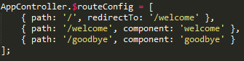
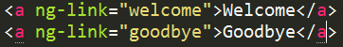
New Router
You need to require ngNewRouter module

Slide 11
Angular 1.4 – Performance boost
~30% faster digest times vs 1.3

Slide 12
Upgrade to 1.4 is very easy
It has very few breaking changes (well document)

Slide 13
Angular 1.5
Work will start after 1.4 is out
Planning will happen in public
Community involvement is the key
Comment / vote on issues you want to see fix
Send pull requests

Slide 14


Angular Team is working on new features for Angular 1

Slide 15

Angular 1 New Features
New Router
Internationalization
Material Design
Migration plan to Angular 2
Support
Notes:
1. Router - Some of the big work we're doing feature-wise for Angular 1 is work that we're going to share with Angular 2, starting with the ROUTER We build this new router for Angular 2 and then back ported in to Angular 1. It focuses on mobile use cases and complex situations in big apps
2. Better i18n
3. Material Design - for Angular 1 then for Angular 2. Layout system based on flexbox
4. Migration plan - They are planning to provide migration guide. John Papa will help them

Slide 16
Use new router Use ES6 modules Use ES6 in general
This will make the migration easier

Slide 17
Release Angular 1 until you are using it
Notes:
Release Angular 1 until the vast majority of you might migrate to Angular 2

Slide 18

Why Angular 2.0?
Performance
The Changing Web
Mobile
Ease of Use
Notes:
When we looked at where we were and where you wanted us to be, we realized that we couldn't get there with the Angular 1 architecture
at least not without making very painful breaking changes
This is why we came up with Angular 2
Angular 2 is now in alpha
You can go see its status on angular.io
It is not ready for building production applications quite yet

Slide 19

Angular 2 Themes
Simpler
Flexible
Productive developers
Fast
Consistent

Slide 20
Angular 2 – Data Binding
Angular 1
Angular 2
Why?
Problems with src, disabled:
<component title="{{expression}}">
<component [title]="expression">
<component disabled="{{exp}}">
<component src="{{exp}}">
<component ng-disabled="exp">
<component ng-src="{{exp}}">

Slide 21
Angular 2 – Event Binding
Expression
Driven by change detection
Statement
Driven by event
<component [prop]="user.name(current)">
<component (event)="user.name(current)">

Slide 22
Angular - Reference
<button (click)="input.focus()">
<input #input type="text" />

Slide 23
Angular 1 - Typos
Can you spot all the errors in here?
<div tytle="{{usor.name}}">
<button ngClick="ctl.click()">
{{usor.name}}
</button>
</div>

Slide 24
Angular 1 - Typos
<div tytle="{{usor.name}}">
<button ngClick="ctl.click()">
{{usor.name}}
</button>
</div>

Slide 25
Angular 2 immediately Typo Errors

Slide 26
Angular 1 ?= Angular 2
Still in Angular 2
Dependency injection
Data binding
Directives
Router
Filters
Animation
Accessibility
Still in Angular 2
i18n
Forms
Expressions
Material Design
Protractor
Karma
Mocks
Notes:
Are the features that I like in Angular 1 still there?
Are the knowledge in Angular 1 maps to this new framework?

Slide 27
New in Angular 2
Web Components
New template syntax
New languages
Ultra-fast change detection
and more…

Slide 28
Differences between components
Angular 1
Service
Directive
Controller
Angular 2
Component
app.factory('SoftUniStore', function () { … });
app.directive('autocomplete', function () { … });
app.controller('softUniController', function () { … });
@Component({ selector: 'my-app' })
@Template({ url: 'templates/softuni' })
class SoftUniComponent { … }

Slide 29
Directives
<input name="title" autocomplete="movie-title">
module.directive('autocomplete', ["autocompleter", function(autocompleter) {
return {
restrict: 'A',
link: function (scope, element, attrs) {
}
}
}]);
Angular 1
Angular 2
@Decorator({ selector: '[autocomplete]' })
class Autocomplete {
constructor(autocompleter:Autocompleter, el:NgElement, attrs:NgAttributes){
}
}

Slide 30
Microsyntax Templates
<ul>
<li template="foreach #item in items">
{{item}}
</li>
</ul>
<ul>
<li *foreach="#item in items">
{{item}}
</li>
</ul>

Slide 31
AtScript
AtScript is a JavaScript base language extending TypeScript
It states that plain JavaScript code is a valid AtScript code
Builds on ECMAScript 6 with types
Extends it by annotations and type introspection
Superset of ES6
Uses TypeScript Syntax
Optional Runtime Type Verification
Type and Metadata Annotations

Slide 32
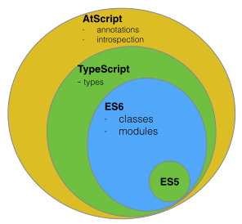
AtScript

Slide 33
AtScript is TypeScript

Slide 34
Traceur
Traceur is a transpiler (compiler) that takes features of future standards
Traceur transpiles them into today JavaScript

Slide 35
Angular 2 Loves Standards

Slide 36
When Angular 2 ships?
First migration – May
Angular 2 – Far in the future

Slide 37

Open Source
with Community Involvement
Notes:
The Angular team have chance to work, not only with people inside the team, but with many talented people outside the team.
Ability to hire some really high quality people. Angular team know your abilities by your contributions
Some of the people in Angular Team are hired from contributors.

Slide 38

How you can help
Add a feature
Contact us
Minimal set of changes per PR
Unit tests
Follow conventions
Work on issues
Write a Plunker or a failing test
Broen at master?
Help closing issues

Slide 39

Resources - What We Need Additionally?
ng-conf
http://www.ng-conf.org/
New Router Concepts
https://www.youtube.com/watch?v=h1P_Vh4gSQY
TODO App
https://github.com/davideast/ng2do
Victor Savkin Blog
http://victorsavkin.com/

Slide 40
Angular 2
Live Demo

Slide 41
Angular 2

